Slide 1
Orasi – Debugging
Intermountain Healthcare

Slide 2
Course Goals
Goals
Understand what a crash is
Use tools to analyze crash
Gather information to file defect
Non-Goals
Debugging expertise

Slide 3
Overview
To discover the root cause of an unhandled exception we can use the Microsoft systems debuggers, cdb or windbg, to debug the process.
We should have symbols for each component we are debugging.
Cdb can be used to:
Get the call stack of an unhandled exception (crash) that is occurring within the process.
Find other issues that are not detected without cdb attached such as first chance access violations (AV) that are hidden bugs.
Provide memory dumps (.dmp files) for developers to debug offline.
Find and debug memory leaks once you know they already exist. This is a more advanced topic but nonetheless, useful.
Notes:
Ljkllk;jl;jk

Slide 4
CrashApp
File, New, Project
Visual C#, Windows, Windows Forms Application
Location: c:\Orasi\VS\Projects
Name: CrashApp (or whatever)

Slide 5
Crash App Controls
Toolbox (floating on left)
Common controls, Button
Properties (F4)
Text: Null Ref
(Name): buttonNullRef
Double-Click on buttonNullRef to get to code.

Slide 6
Crash App – Null Ref Code
FileStream f = null;
string path = @"c:\orasi\VS\Projects\Data\Customer.txt";
if (File.Exists(path))
{
f = File.OpenRead(path);
}
f.Close();

Slide 7
CrashApp - Run
Run from VS – F5
Make it fail
Run from Windows File Explorer

Slide 8
CrashApp – Stack Overflow code
private void button2_Click(…)
{
f1();
}
private void f1()
{
f1();
}

Slide 9
Setting up Debuggers
Install cdb on the machine that will be running the process that will be monitored:
http://msdn.microsoft.com/en-US/windows/hardware/hh852363
Click Install and Download
Ignore that it mentions Windows 8
Uncheck every option except
Windows Performance Toolkit
Debugging Tools for Windows

Slide 10
Configuring System PATH
We need to add the debugging directory to the System Path which sets the symbols path permanently
In Start menu, right click on Computer, choose Properties, Advanced System Settings, Environment Variables…, System variables
Find variable name Path.
Click Edit, then hit the End key to go to the end of the line.
Carefully append the following text that begins with a semi-colon:
;C:\Program Files (x86)\Windows Kits\8.0\Debuggers\x86

Slide 11
_nt_symbol_path - Temporary
Set the default symbols path for operating system symbols
There is an environment variable named _nt_symbol_path that all Microsoft tools look for. Yes, the path begins with an underscore, and if you don’t include it, it won’t work.
Set the Symbol path from the command line
When debugging from the command line the following command can be used with semi-colon delimiters between paths.
set _nt_symbol_path=srv*http://msdl.microsoft.com/download/symbols

Slide 12
_nt_symbol_path - Permanent
Set the symbols path permanently
Right click on My Computer, Properties, Advanced System Settings, Environment Variables, System, New
Variable name: _nt_symbol_path
Variable value:
srv*http://msdl.microsoft.com/download/symbols

Slide 13
Using Cdb - Connecting
Cdb /?
Cdb –pn crashapp.exe
Cdb -g –G –pn crashapp.exe
Cdb –p 992
Cdb –g –G crashapp.exe

Slide 14
Using Cdb - Disconnecting
Ctrl + C – to break in
To quit and terminate the application
q - quit
To detach and leave the application running
.detach – to disconnect
q – to quit

Slide 15
Using Cdb – create dump file
Ctrl + C
.dump /ma c:\orasi\Crashapp1.dmp
Exit
To quit and terminate the application
q - quit
To detach and leave the application running
.detach – to disconnect
q – to quit

Slide 16
Using Cdb – debug dump file
Cdb –z c:\orasi\Crashapp1.dmp
.dumpcab –a c:\orasi\Crashapp1.cab
q – to quit

Slide 17
Using cdb – help commands
When debugging a process or dump file:
? – help
.help – dot commands help
!help – extensions help
.hh – load windows help file

Slide 18
Using Cdb - commands
lm – load modules (list modules)
Lm v mclr – show info about module (clr)
.sympath – show symbols path
| - show process information (pipe)
.reload – reload symbols
.reload /f – force reload symbols
.reload /f clr – force reload one module

Slide 19
Using Cdb - Logging
.logopen c:\orasi\Crashapp1.log
.logclose
.logappend c:\orasi\Crashapp1.log

Slide 20
Using Cdb - commands
Kb – stack backtrace
~ - list all native threads
~*kb – list stacks on all threads
~3s – change to thread id 3

Slide 21
Using Cdb - Managed
.loadby sos clr – Loads add-in SOS (Son of Strike)
!sos.help – SOS help
!threads
!dumpstack
!clrstack
!analyze –v

Slide 22
Setting up Symbols
You can end up spend more time getting correct symbols than debugging the failure.
Symbols are needed at debugging time to determine the root cause of a failure or memory leak.
Symbols are not needed at runtime, meaning that while the test is running, the symbols are not needed.
They are only needed after a failure has occurred and you intend to debug the failure.
I usually don’t debug a failure on the machine that the failure occurred on; we can create a dump file of the failure and debug the dump file at a later time on another system.
This allows your test machines to keep finding new failures and saving dump files, while you debug them at your leisure.
I explain the dump commands below, so pay special attention.

Slide 23
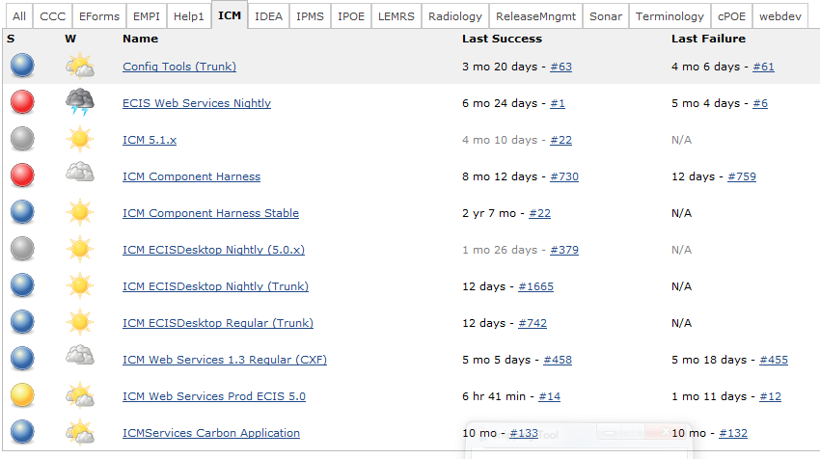
Getting Intermountain Symbols
Symbols are provided on “Jenkins”. Go to the Jenkins Url below.
http://lpv-ecismig01:8080/view/ICM%20/

